Slide 1
HNDIT1104: Data Representation and Organization
Describing Logic Gates & Circuits
Lesson 14

Slide 2
Logic Gates
A Logic gate is a device that performs a basic operation on electrical signals
Gates are combined into circuits to perform more complicated tasks

Slide 3
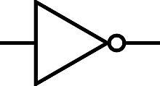
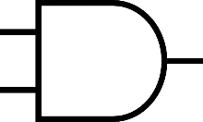
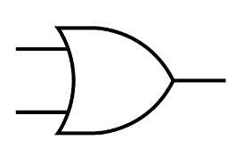

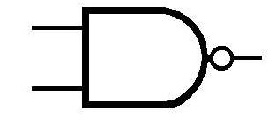
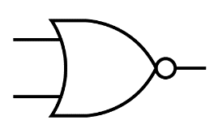
Logic Gates
Let’s examine the processing of the following six types of gates
  NOT
  AND
  OR
  XOR
  NAND
  NOR

Slide 4
Describing Gates and Circuits
There are three different, but equally powerful, notational methods
for describing the behavior of gates
and circuits
  Boolean expressions
  logic diagrams
  truth tables

Slide 5
Describing Gates and Circuits
Boolean algebra: expressions in this algebraic notation are an elegant and powerful way to demonstrate the activity of electrical circuits
  Basic propositional statements are unambiguously either True or False
  Operations such as AND or NOT are then performed on these values
  A gate is simply a mechanical way to perform such a boolean operation

Slide 6
Describing Gates and Circuits
Logic diagram: a graphical representation of a circuit
  Each type of gate is represented by a specific graphical symbol
Truth table: defines the function of a gate by listing all possible input combinations that the gate could encounter, and the corresponding output

Slide 7
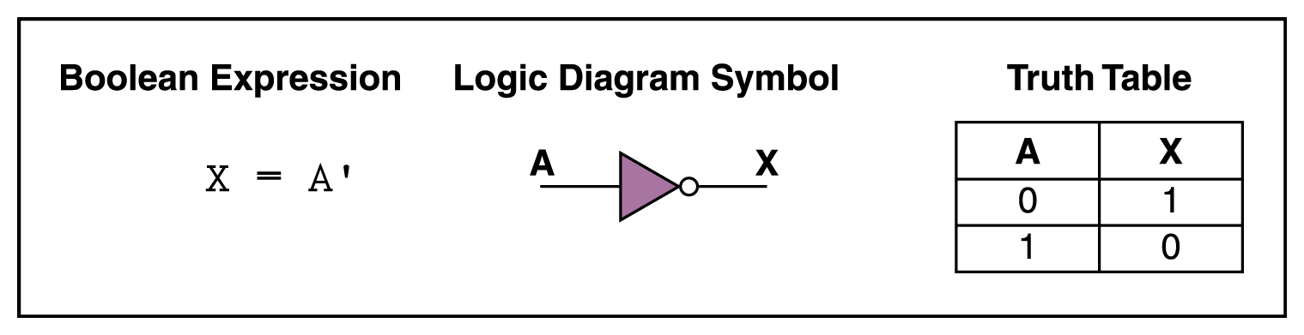
NOT Gate
a NOT gate accepts one input value
and produces one output value
a NOT gate is sometimes referred to as an inverter because it inverts the input value

Slide 8
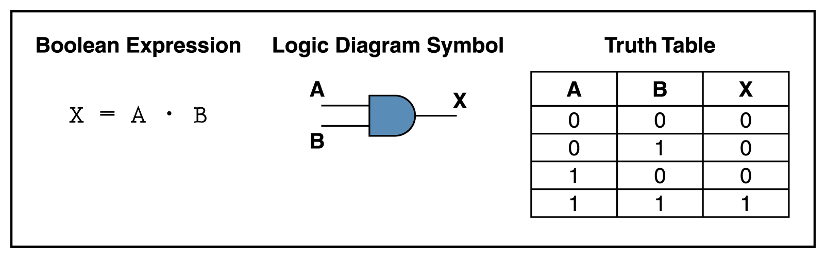
AND Gate
An AND gate accepts two input signals
If the two input values for an AND gate are both 1, the output is 1; otherwise, the output is 0
Figure 4.2 Various representations of an AND gate

Slide 9
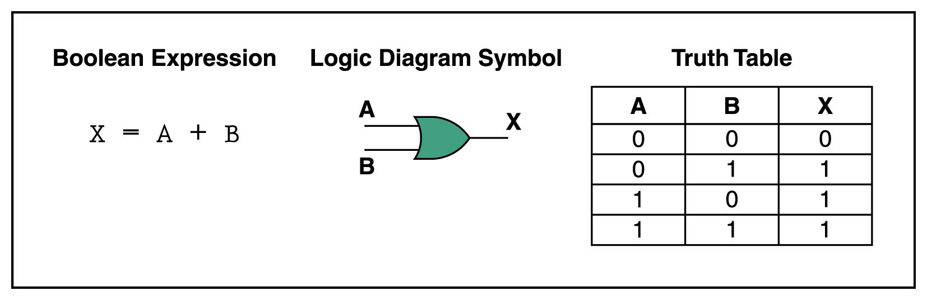
OR Gate
If the two input values are both 0, the output value is 0; otherwise, the output is 1
Figure 4.3 Various representations of a OR gate

Slide 10
XOR Gate
XOR, or exclusive OR, gate
  An XOR gate produces 0 if its two inputs are the same, and a 1 otherwise (produces 1 when two inputs are different each other)
  Note the difference between the XOR gate
  and the OR gate; they differ only in one
  input situation
  When both input signals are 1, the OR gate produces a 1 and the XOR produces a 0

Slide 11
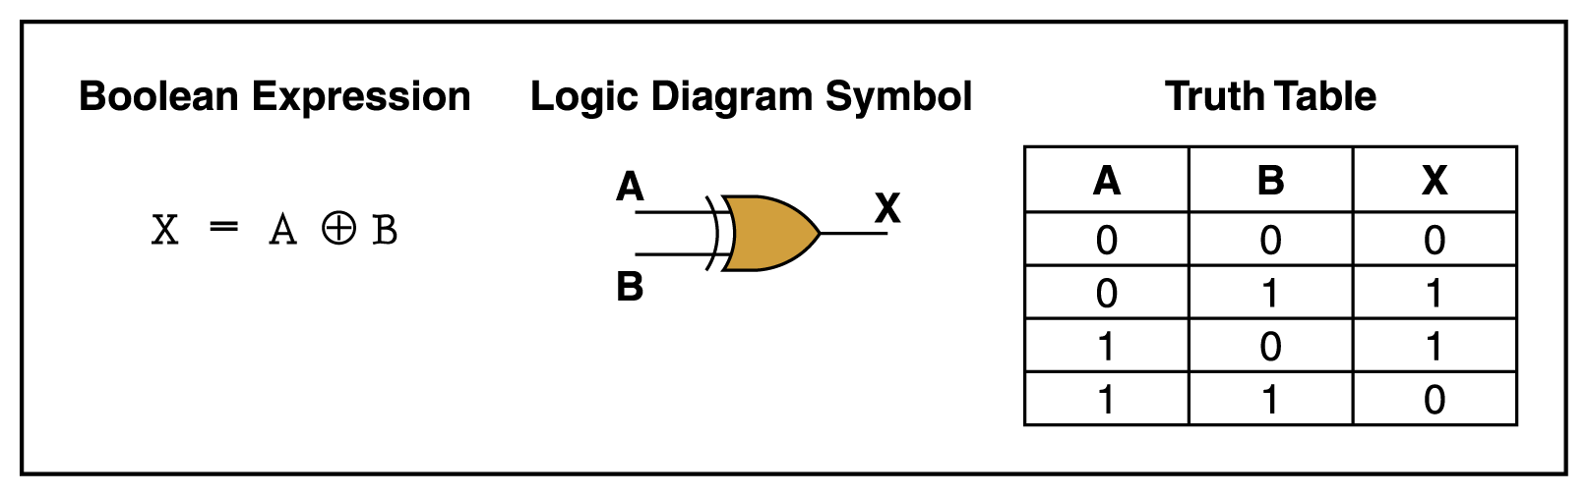
XOR Gate
Figure 4.4 Various representations of an XOR gate

Slide 12
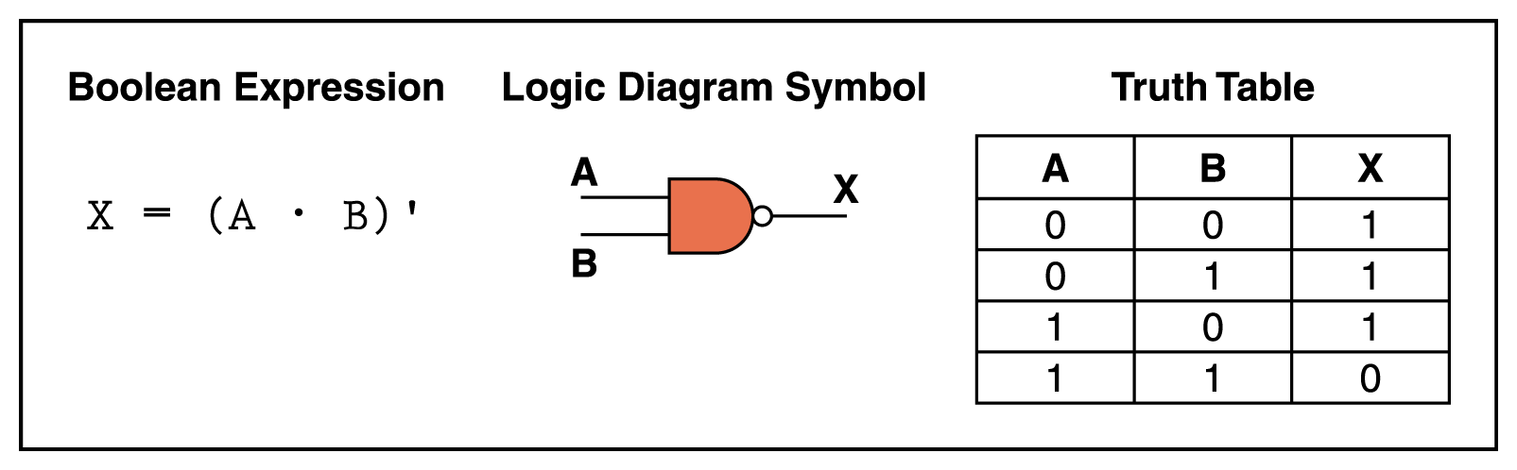
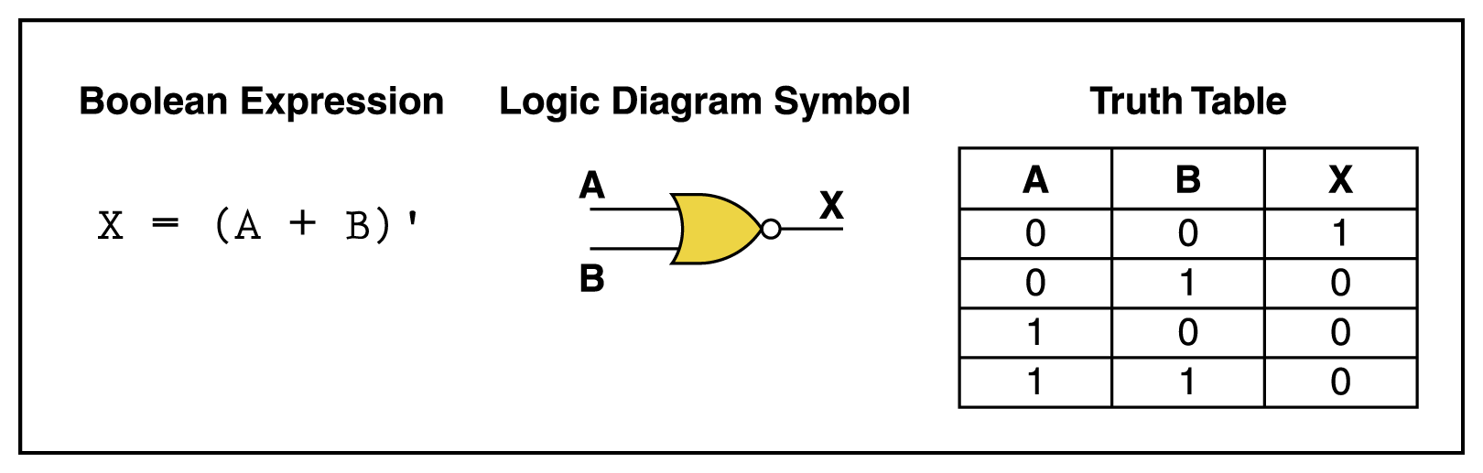
NAND and NOR Gates
The NAND and NOR gates are essentially the opposite of the AND and OR gates, respectively
Figure 4.5 Various representations of a NAND gate
Figure 4.6 Various representations of a NOR gate

Slide 13
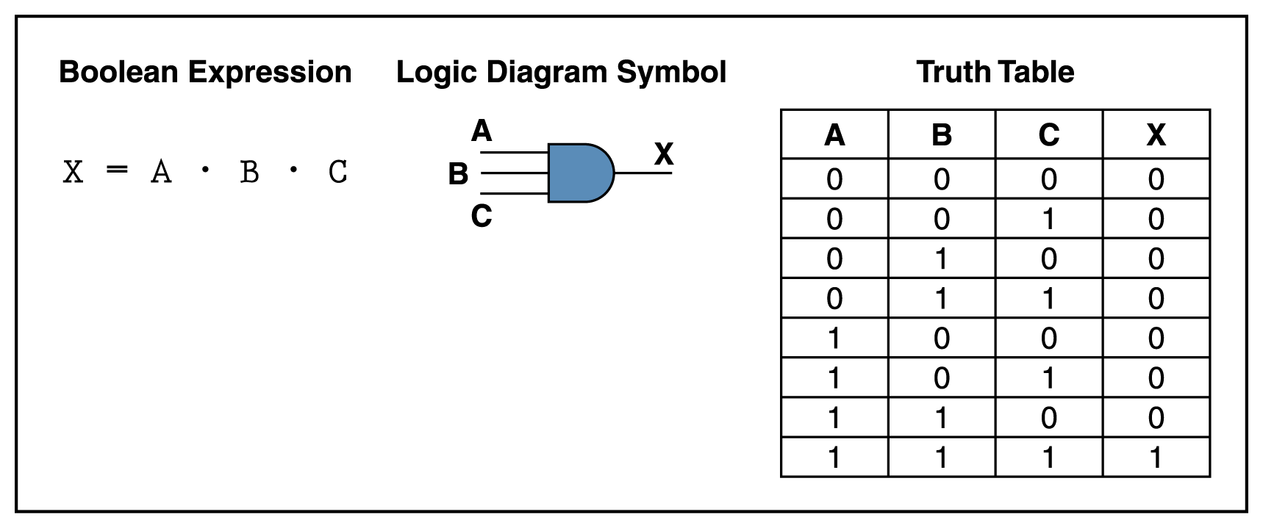
Gates with More Inputs
Gates can be designed to accept three or more input values
A three-input AND gate, for example, produces an output of 1 only if all input values are 1
Figure 4.7 Various representations of a three-input AND gate

Slide 14
As with gates, we can describe the operations
of entire circuits using three notations
  Boolean expressions
  logic diagrams
  truth tables

Slide 15
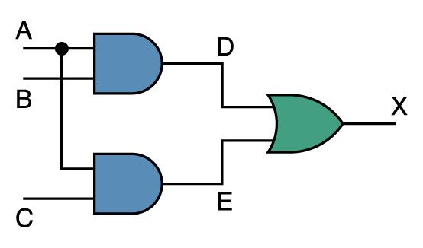
Combinational Circuits
Gates are combined into circuits by using the output of one gate as the input for another
Page 99

Slide 16
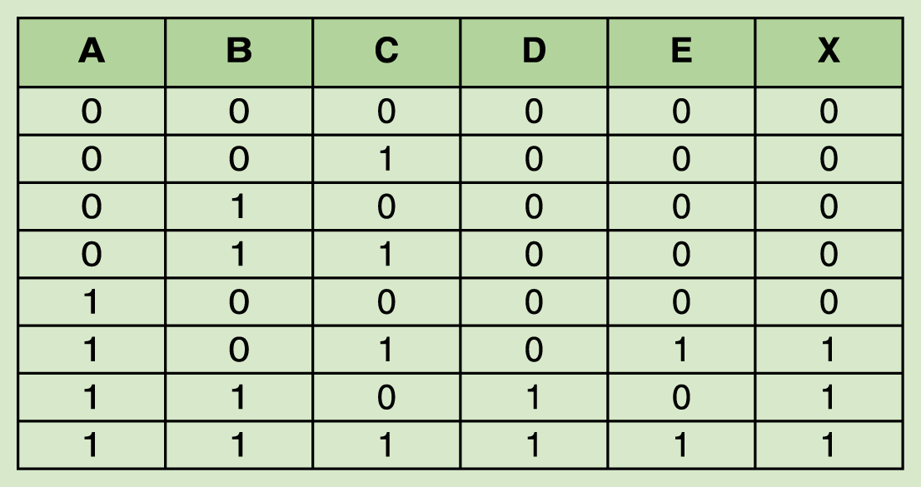
Combinational Circuits
Page 100
Because there are three inputs to this circuit, eight rows are required to describe all possible input combinations
This same circuit using Boolean algebra:
(AB + AC)

Slide 17
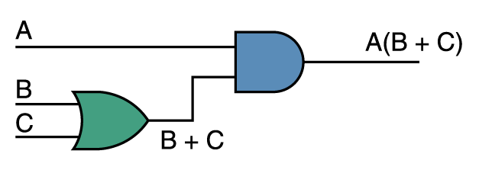
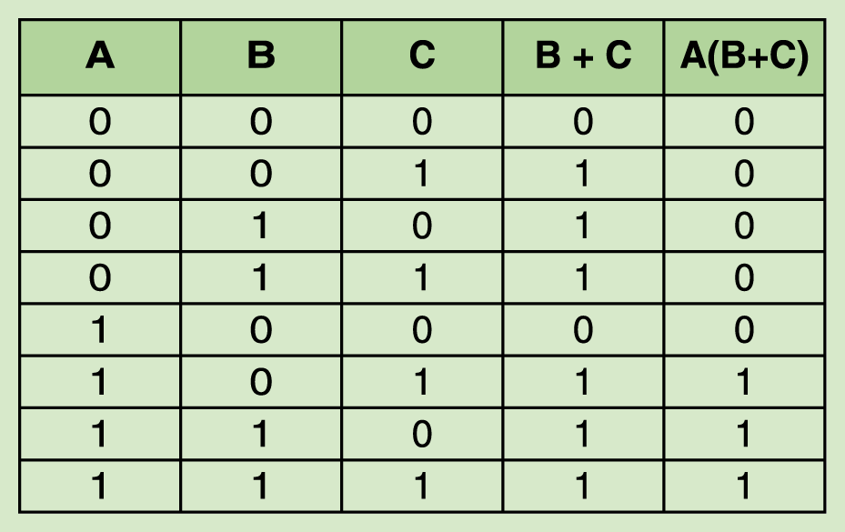
Now let’s go the other way; let’s take a Boolean expression and draw
Consider the following Boolean expression: A(B + C)
Page 100
Page 101
Now compare the final result column in this truth table to the truth table for the previous example
  They are identical

